Slide 1

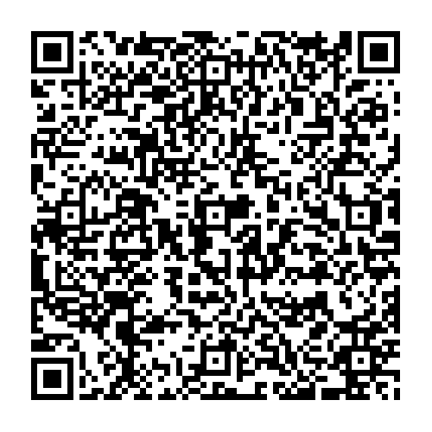
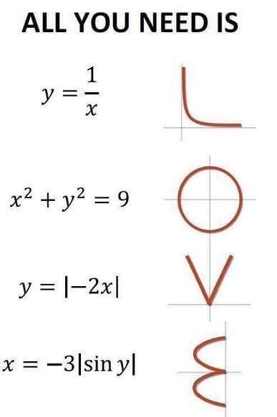
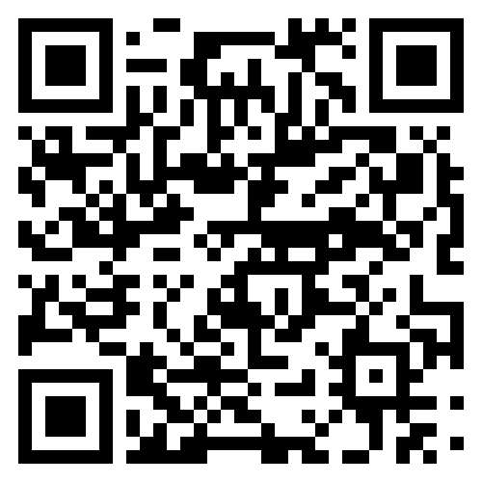
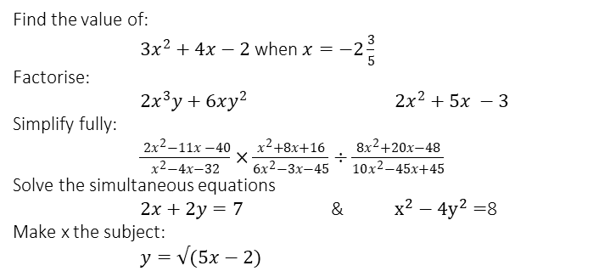
SUBJECT: Further Mathematics
Core Pure Mathematics enables extended study beyond the content of Maths A level, such as vectors, calculus to study Volumes of Revolution and new areas of mathematics such as matrices, complex numbers, polar coordinates and hyperbolic functions. You also study optional units in Further Statistics, Further Mechanics and Further Pure. You will be given a choice of which 2 optional units to study
Scan for Specification
BEFORE YOU START
George Green
Textbook: We provide textbooks for classwork along with access to electronic copies and revision materials
Calculator: You will need to purchase a Casio fx-991CW (essential) OR a graphical calculator Casio fx-CG100 (optional, there are some useful functions for Further Maths students). These can be purchased through school in September.
George Green (14 July 1793–31 May 1841) was a British mathematician and physicist.
He was born and lived for most of his life in Sneinton. He worked in his father’s windmill, At some point he began to study mathematics, and while almost entirely self taught he went on to graduate from Cambridge and become a faculty member.
A little bit of history…
Algebra Health Check
These are all GCSE algebra questions that we would expect you to be able to do already.
Check that you can:
Find the value of:
$3x^{2}+4x−2$ when $x=−2\frac{3}{5}$
Factorise:
$2x^{3}y+6xy^{2}$ $2x^{2}+5x −3$
Simplify fully:
$\frac{ 2x^{2}−11x −40}{x^{2}−4x−32}×\frac{x^{2}+8x+16}{6x^{2}−3x−45}÷\frac{8x^{2}+20x−48}{10x^{2}−45x+45}$
Solve the simultaneous equations
$2x+2y=7$ & $x^{2}−4y^{2}=$8
Make x the subject:
$y=√(5x−2)$
Is A-Level Further Maths for you?
Scan the QR code to the right and work through the exercises to practise the skills that you will need. The answers to each of these exercises are also available.
This work will prepare you for a “diagnostic” test at the beginning of term, to see what knowledge you have after studying for your GCSE’s.
What A-Level Further Mathematics is involved with the following professions?
Cybersecurity or Crpytologist
Meteorological Modelling
Statistician
Preparation Tasks
CAREERS TASK
Link to summer tasks preparation page.

Slide 2
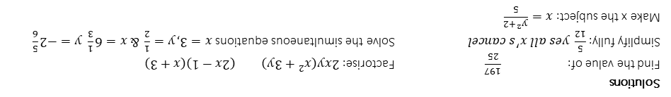
SUBJECT: Mathematics
I have always enjoyed maths This is the best reason for choosing maths A level because you will need to work hard at it, so enjoying the challenge and being willing to persevere and put the time into practising new skills is an essential aspect of your studies.
Universities respect a Maths A level above many other subjects This is certainly true but take care as your offer from university depends on the grades that you are going to get. Check that you have the mathematical ability and interest in the subject to ensure that you will achieve a high grade. It is not sensible to choose A level maths if your GCSE grade is below grade 7.
They won’t let me study Physics unless I do maths This is often the rule in many sixth forms because A level physics relies heavily on good algebra skills and the mechanics component of A level maths supports physics. Watch out though, this might just mean that you will struggle in both physics and maths if these skills are not secure enough, or if you are not prepared to put in the practice needed.
I have always been good at maths Being confident about your mathematical skills is certainly an essential quality, as you need to be willing to show resilience with problem solving and persevere with brand new concepts. Remember that the A level maths curriculum is heavily dependent on advanced algebra skills and applied problem-solving skills are key components of the course.
I want to be an engineer so I need to improve my algebra skills Engineering is a broad and varied career aspiration. Degree level engineering is highly dependent on A level maths skills but a certain level of existing skills are essential to access the A level maths course, as we do not reteach skills that you should have already developed at GCSE. You need to have studied the higher tier syllabus at GCSE and be confident with most of the algebra content to study maths at A level.
I’m not good at writing and there isn’t much writing in maths This might be true but watch out, our students often run into problems in exams if they are not prepared to take the time to read all the detail of lengthy wordy questions. Most importantly, A level maths involves developing the art of good mathematical writing – constructing well-structured algebraic reasoning to prove a result as well as explaining. A level maths is certainly not just about finding answers.
I’ve got to choose three subjects so I might as well choose maths If this is your only reason for choosing maths, think again. Maths A level requires hard work and self-discipline. If you are not enthusiastic about the subject you are very unlikely to be successful. This goes for your other subject choices too.
Is A-Level Maths for you?
Solutions
Find the value of: $\frac{197}{25}$ Factorise: $2xy(x^{2}+3y)$ $(2x−1)(x+3)$
Simplify fully:$\frac{5}{12} yes all x^{′}s cancel$ Solve the simultaneous equations $x=3, y=\frac{1}{2} \& x=6\frac{1}{3} y=−2\frac{5}{6}$
Make x the subject: $x=\frac{y^{2}+2}{5}$

