Slide 1

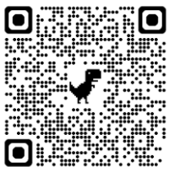
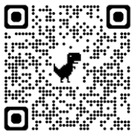
BTEC Engineering
The BTEC level 3 engineering course is designed to enable students to experience a wide range of disciplines they would expect to experience within the engineering sector. Students will acquire new knowledge and skills that will provide a natural transition onto either an engineering degree, apprenticeship or degree apprenticeship.
Scan for Specification
BEFORE YOU START
Using key vocabulary is vital at A level. Research the following key terms for the 1st topic and create a glossary.
• Coplanar Forces
• Stress
• Strain
• Kirchhoff’s Laws
• Rectification
• Transformers
• Resistance
• Impedance Create this glossary electronically so you can add or amend easily.
Key revision guide: Pearson REVISE BTEC National Engineering revision guide ISBN: 978-1292150284
Equipment Required: Scientific calculator, pens, pencils, highlighters & a folder with dividers
Useful Apps: Fusion 360, AutoCAD, Circuit wizard
LITERACY TASK
Design and Manufacturing
Design and manufacture your own hand operated Automata that clearly demonstrates the following forms of motion:
• Rotary motion
• Oscillatory motion
• linear motion
• irregular motion
Watch the video linked to the QR code above to help you understand these wonderful creations!
Click the link below to see more complex Automata
Curious Contraptions | Paul Spooner | Exploratorium – YouTube
Could you show how these forms of motion can be created?
Are you able to construct your own working
KNOW THIS TASK
Mini Project: Choose a product that interests you. This should be an everyday item that you have at home. It should be something you have easy access to for photography and research reasons.
1.Take digital camera images of the product and upload onto a power point document.
2. Mind map how you could improve the product in some way. This should be done by hand in real-time and then scanned or photographed, copied and paste onto your document or attached as a separate sheet.
3. Produce a concept design sheet of possible improvements.
(A4 sheet with as many rough sketches you can think of.)
4. Share your ideas with friends or family and record their
responses to your suggestions on your document
5. Evaluate your thoughts and the feedback of others and
use this to redesign one of your original ideas.
This should be as follows:
• A main sketch in 3D
• Secondary sketches to explain the improvement in detail
• Annotations to help explain your ideas
Research and list 10 careers in
Choose three from the list and outline the role and expectations in more detail
Review those three to show why you would be interested or suitable for that career
DO THIS TASK
CAREERS TASK

