Slide 1

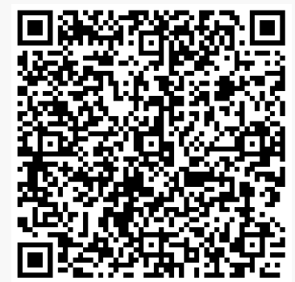
History
Our two year A Level covers the Early Tudors 1485-1558, the French Revolution and Napoleon, 1774-1815 and Russia 1855-1964. Students will also complete an extended piece of work on a topic of their choice.
Scan for Specification
BEFORE YOU START
Find the definitions of:
Ancien Regime
Absolutism
Estates System
Philosophes
Dynasty
Pretender
Usurper
Dynastic marriage
Key textbooks: France in Revolution by Dylan Rees
Tudor England by John Guy
Key Website:
https://www.mrallsophistory.com/revision/category/a-level-and-ib-history-revision/the-french-revolution
https://tudorhistory.org/
LITERACY TASK
Early Tudors
https://www.ocr.org.uk/Images/170128-specification-accredited-a-level-gce-history-a-h505.pdf
Access and read the OCR A level History specification using the link above. We study
the Early Tudors (Y106) P.g 26 . Look up these the component to see what topics we study.
Task You will need to learn all about the first Tudor King, Henry VII, the father of the
great Henry VIII. To begin with do the following:
• Watch the Henry VII Winter King documentary via the link. https://www.youtube.com/watch?v=aBpSRQ6wVPU
• Then create a summary of his life.
Write a response to the question- Was Henry VII ever secure as King of England?
KNOW THIS TASK
Produce a project of your own work on Napoleon, the leader of France 1799-1815. You will need to research Napoleon’s life and career and must try to include:
A brief timeline of key events in Napoleon’s life.
A summary of reforms he introduced in France.
The successes and failures in Napoleon’s military campaigns
A substantiated judgement on how far you agree Napoleon was a great leader.
Research and list the key skills you will gain in History
Choose three from the list and outline how these skills will help with possible careers paths.
DO THIS TASK
CAREERS TASK

