Slide 1

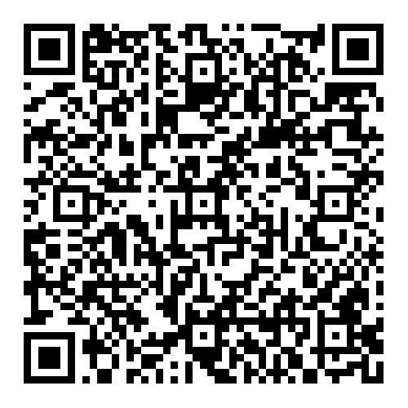
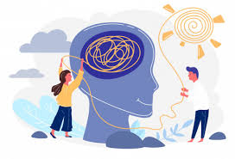
PSYCHOLOGY
A Level Psychology explores a wide range of topics – from memory to obedience; from mental health to early attachment relationships. We explore the competing theories that explain them; evaluate the quality of evidence supporting them; and apply them to real life situations and people.
Scan for Specification
BEFORE YOU START
KEY TERMS
Write definitions for the following key terms:
Nature
Nurture
Free will
Hard determinism
Reductionism
Holism
Ethics
Key textbook: you will get free access to an online copy of the Illuminate AQA Psychology for A Level textbooks and hard copies of relevant revision and study guides when you start Year 12.
Key Website: check out the Bear It In Mind YouTube channel and Learndojo website.
LITERACY TASK
3:2:1 Is Psychology a science?
Psychology’s status as a science is a source of debate. This is important because it relates to how credible and useful the subject is – as well as highlighting some of the challenges of studying human behaviour.
Find three arguments supporting the view that Psychology IS a science.
Find two arguments against the view that Psychology IS a science.
Give one yes/no answer to this question - and explain your reasoning.
KNOW THIS TASK
BPS Research Digest
Psychological research is happening all the time. This keeps the subject relevant and allows accepted theory to be tested, and when necessary, adapted or even rejected!
Go to the BPS (British Psychological Society) Research Digest and choose one study that looks interesting to you.
Talk with a friend and/or relative about:
- The research question
- How they researched it
- What they found
- Strengths and weaknesses of the study
Research and list 10 careers in
Choose three from the list and outline the role and expectations in more detail
Review those three to show why you would be interested or suitable for that career
DO THIS TASK
CAREERS TASK

