Slide 1

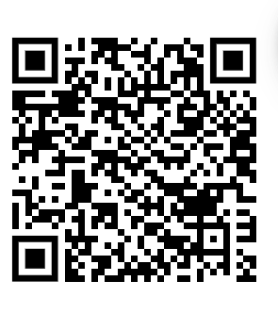

SUBJECT
Our two year A-Level covers:
Paper 1: Education with Theory and Methods
Paper 2: Families and Households with Beliefs in Society
Paper 3: Crime and Deviance with Theory and Methods
BEFORE YOU START
Find the definitions for the following terms:
Functionalism
Interactionalism
Marxism
Feminism
Secularisation
Deviance
Post-Modernism
Key textbook: AQA A Level Sociology Book 1 – Napier Press
Key Website: https://www.tutor2u.net/sociology
LITERACY TASK
Sociology is made up of different theoretical perspectives. Each perspective views society through its own unique lens.
You need to know the specific differences between sociological perspectives.
Create a poster/guide that gives an overview of different sociological perspectives such as Functionalism, Marxism and Post-Modernism.
You must include:
How does the theory view society?
Who are the key thinkers and their ideas?
What are the strengths and limitations of the theory?
KNOW THIS TASK
Watch the documentary – School Swap: The Class Divide and answer the questions below:
https://www.youtube.com/watch?v=HDvJXnbCAs8
What percentage of the British population have attended a private school?
How much does it cost to attend Warminster school as a boarder?
Make a list of the main differences between Warminster private school and Bemrose state school e.g. facilities, staffing, extracurricular activities
How does attending a private school enhance the life chances of pupils e.g. job prospects, aspirations etc.
Research and list 10 careers in Sociology
Choose three from the list and outline the role and expectations in more detail
DO THIS TASK
CAREERS TASK

